Slide 1
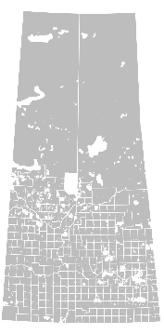

Prediction of crop production in rural municipalities of Saskatchewan
Using Clustering and LSTM methods
Presented by MARUF AHMAD

Slide 2

Problem Statement
Accurately predicting crop production in rural municipalities of Saskatchewan is challenging due to the variability in climate, soil conditions, and farming practices. This uncertainty can lead to inefficient resource allocation and planning, affecting the livelihood of farmers and the agricultural economy.

Slide 3

Solutions
Clustering: We utilized K-means clustering to identify localized crop production patterns. This helps in segmenting the data into meaningful groups for targeted analysis.
Prediction: For future crop production prediction, we implemented an LSTM-based Recurrent Neural Network (RNN). LSTM networks are well-suited for handling time series data and forecasting future trends.

Slide 4
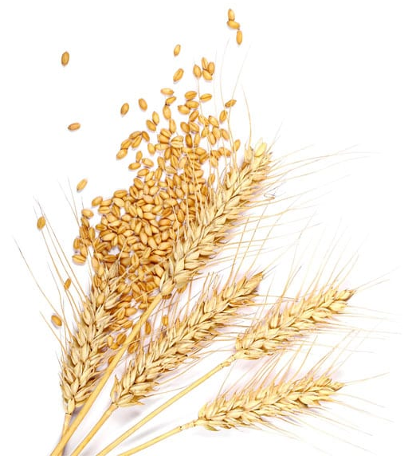
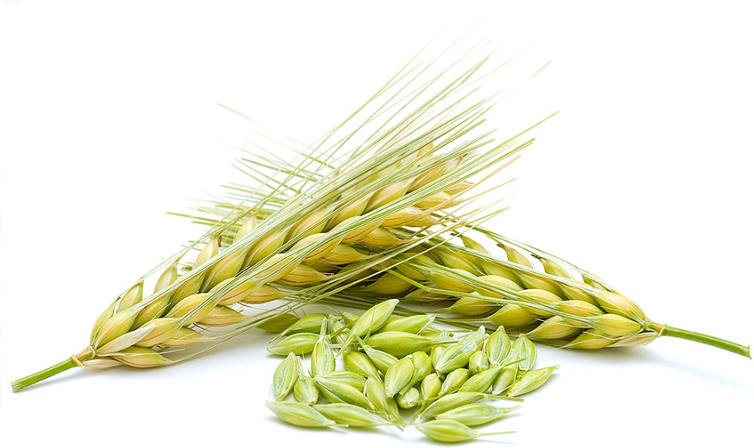
Crops:
Focus on two major crops
Oats
Barley

Slide 5
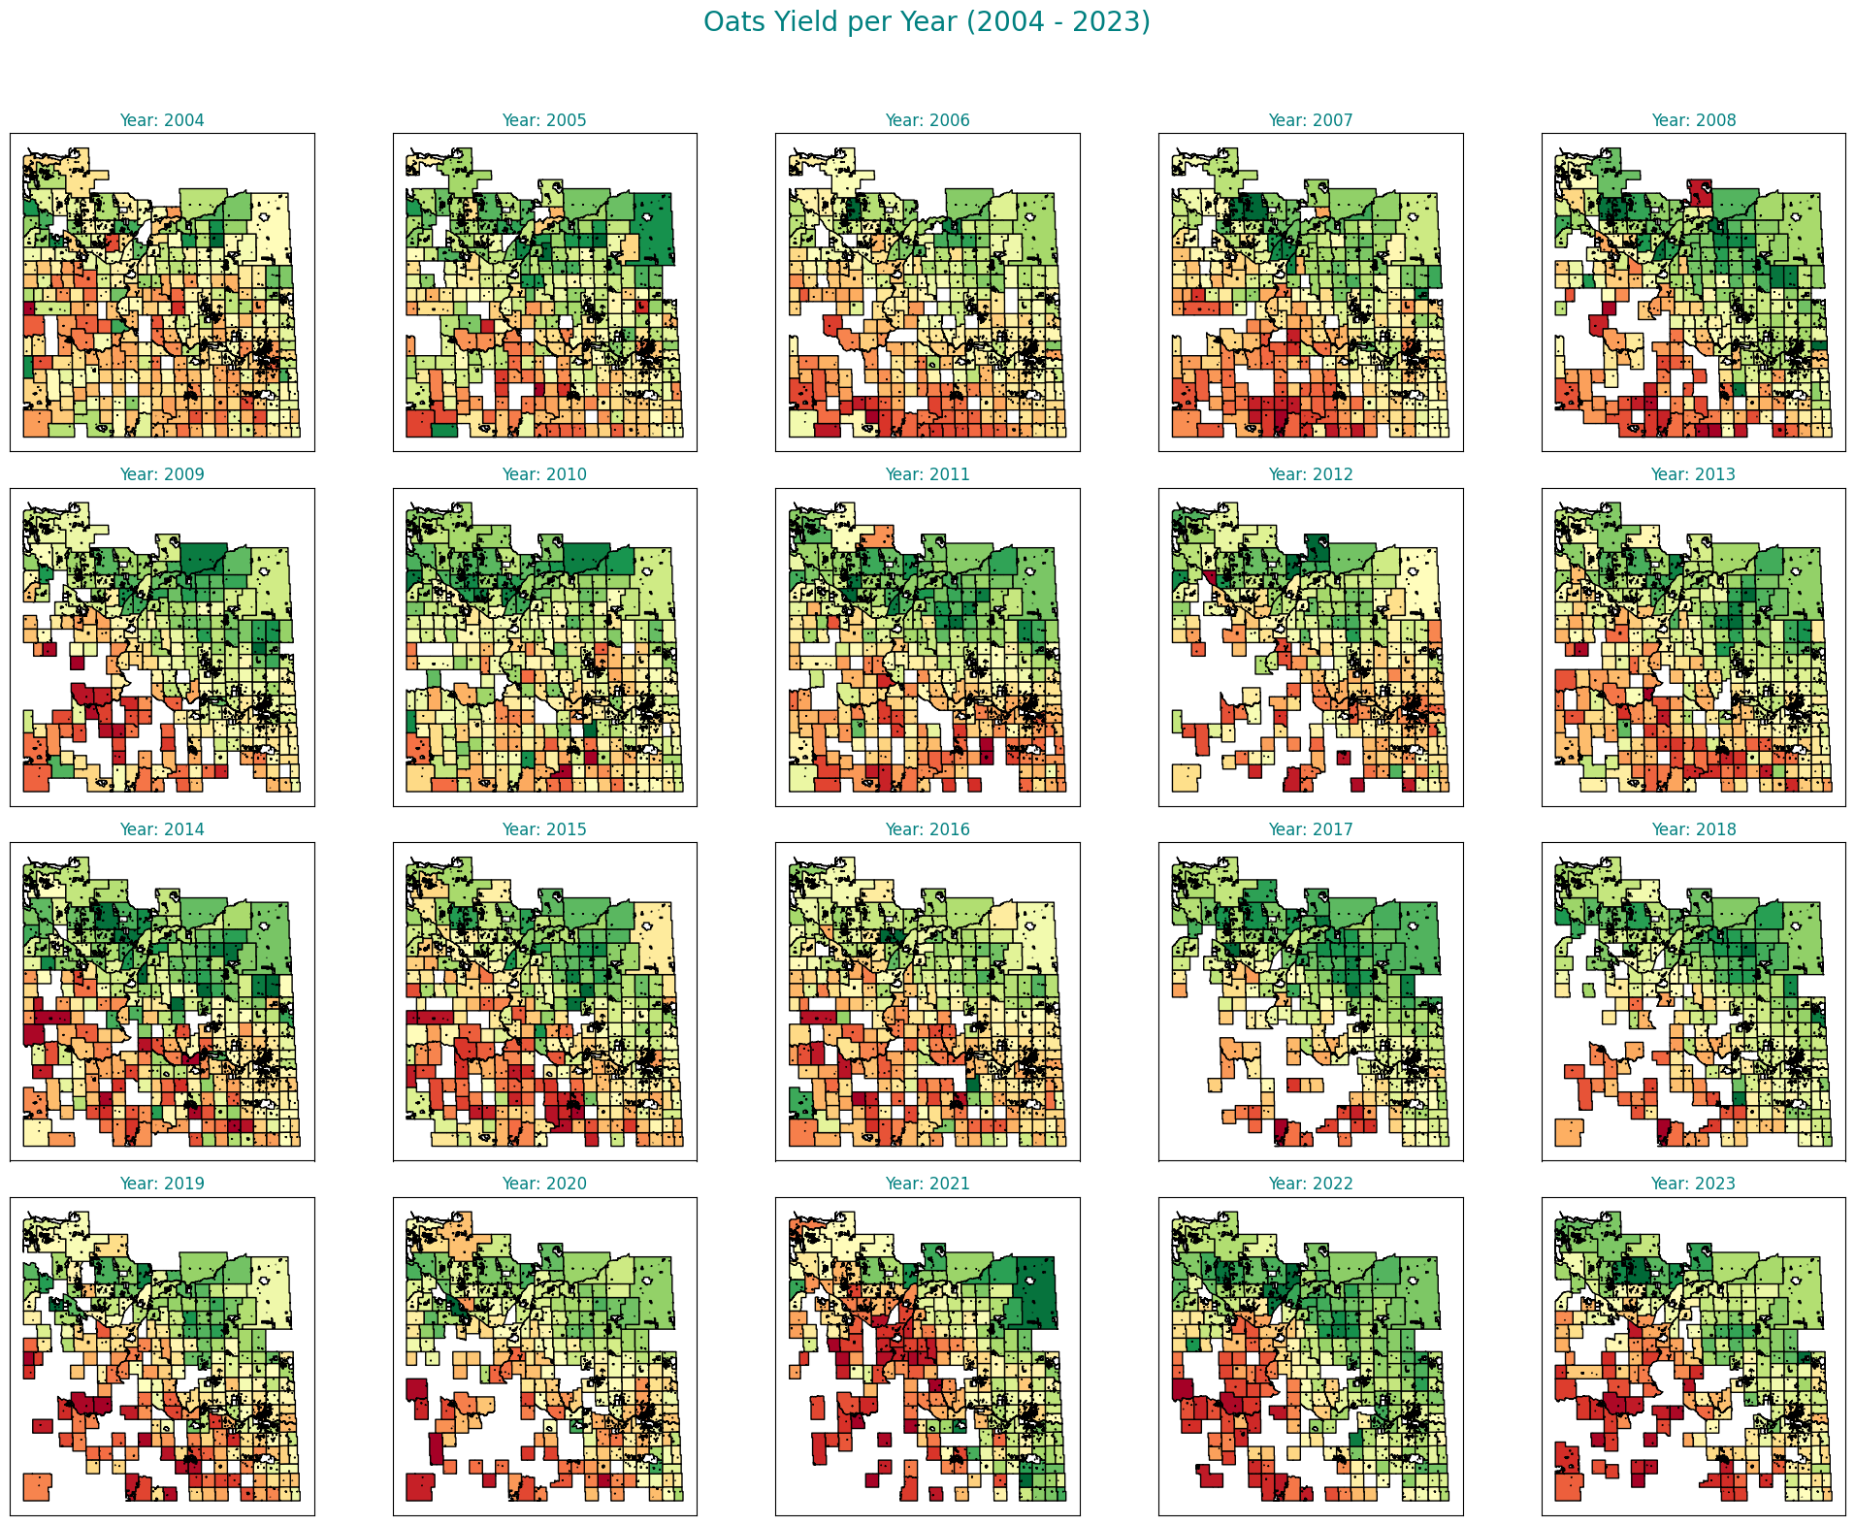
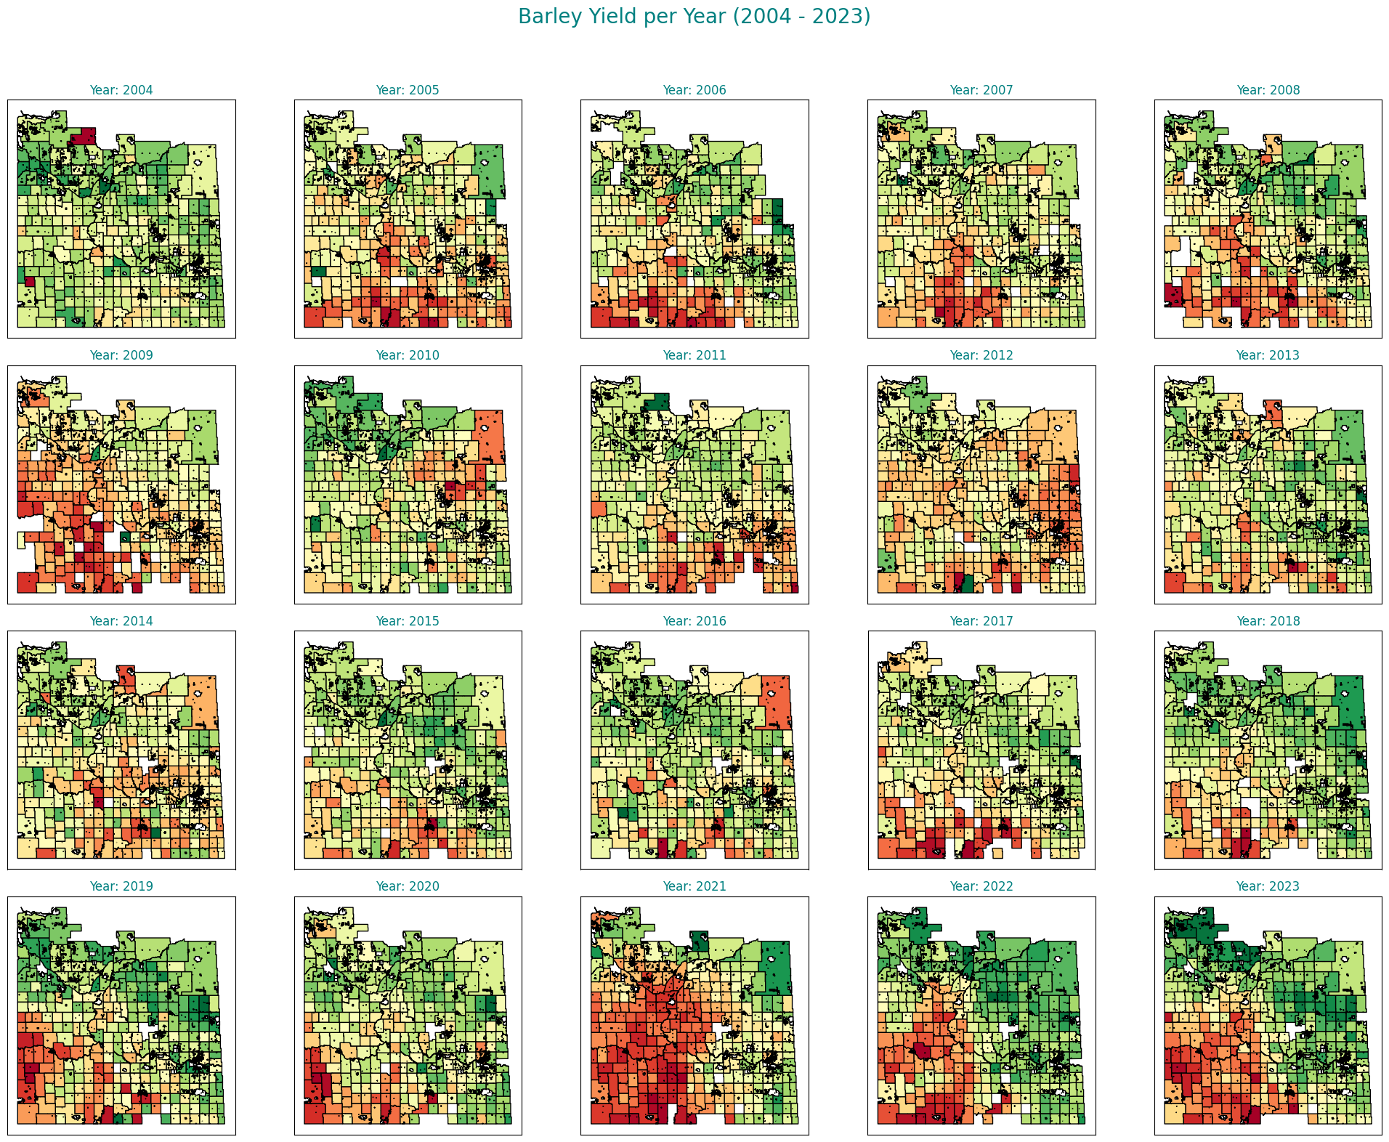
Exploratory Data Analysis

Slide 6
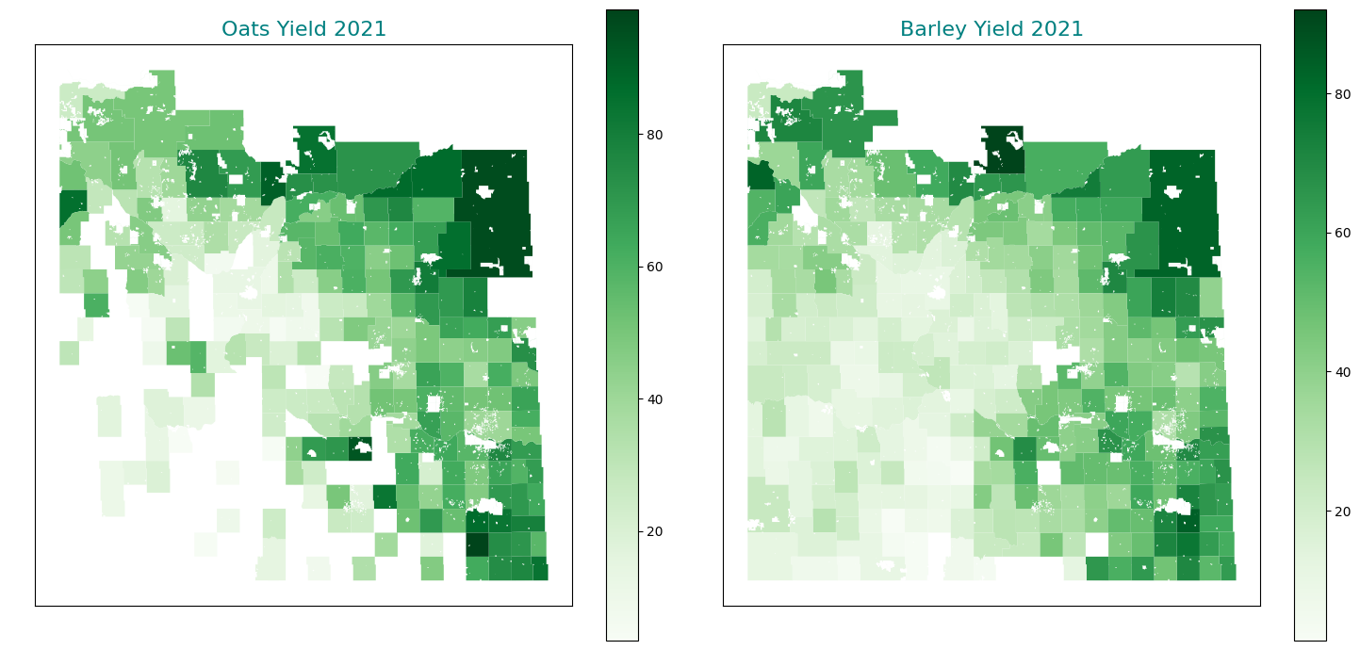
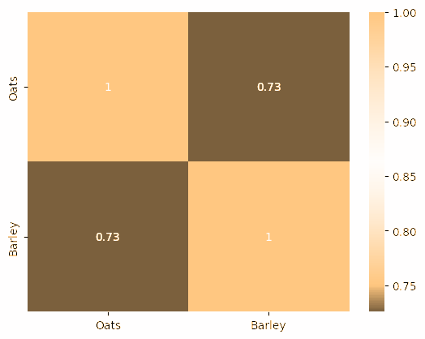
Spatial Distribution of Oats and Barley Yields in (2021) and their correlation
Correlation graph
Visual representation of the correlation between different variables.
Highlights the relationships that influence crop production.

Slide 7
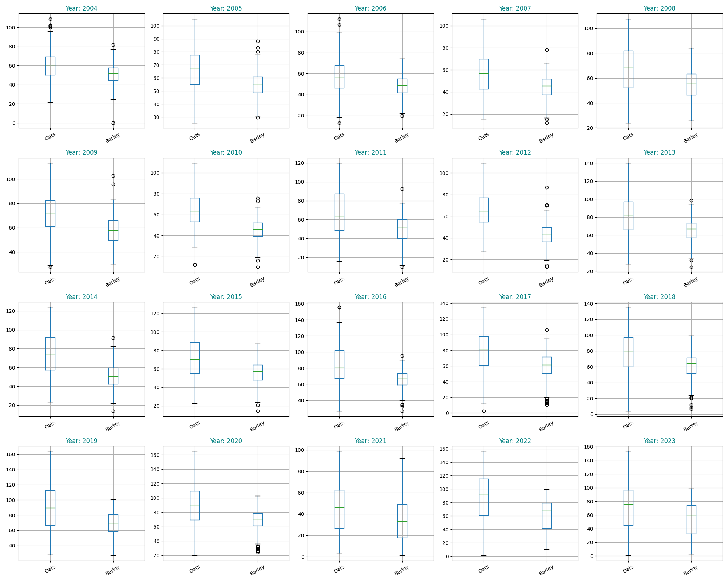
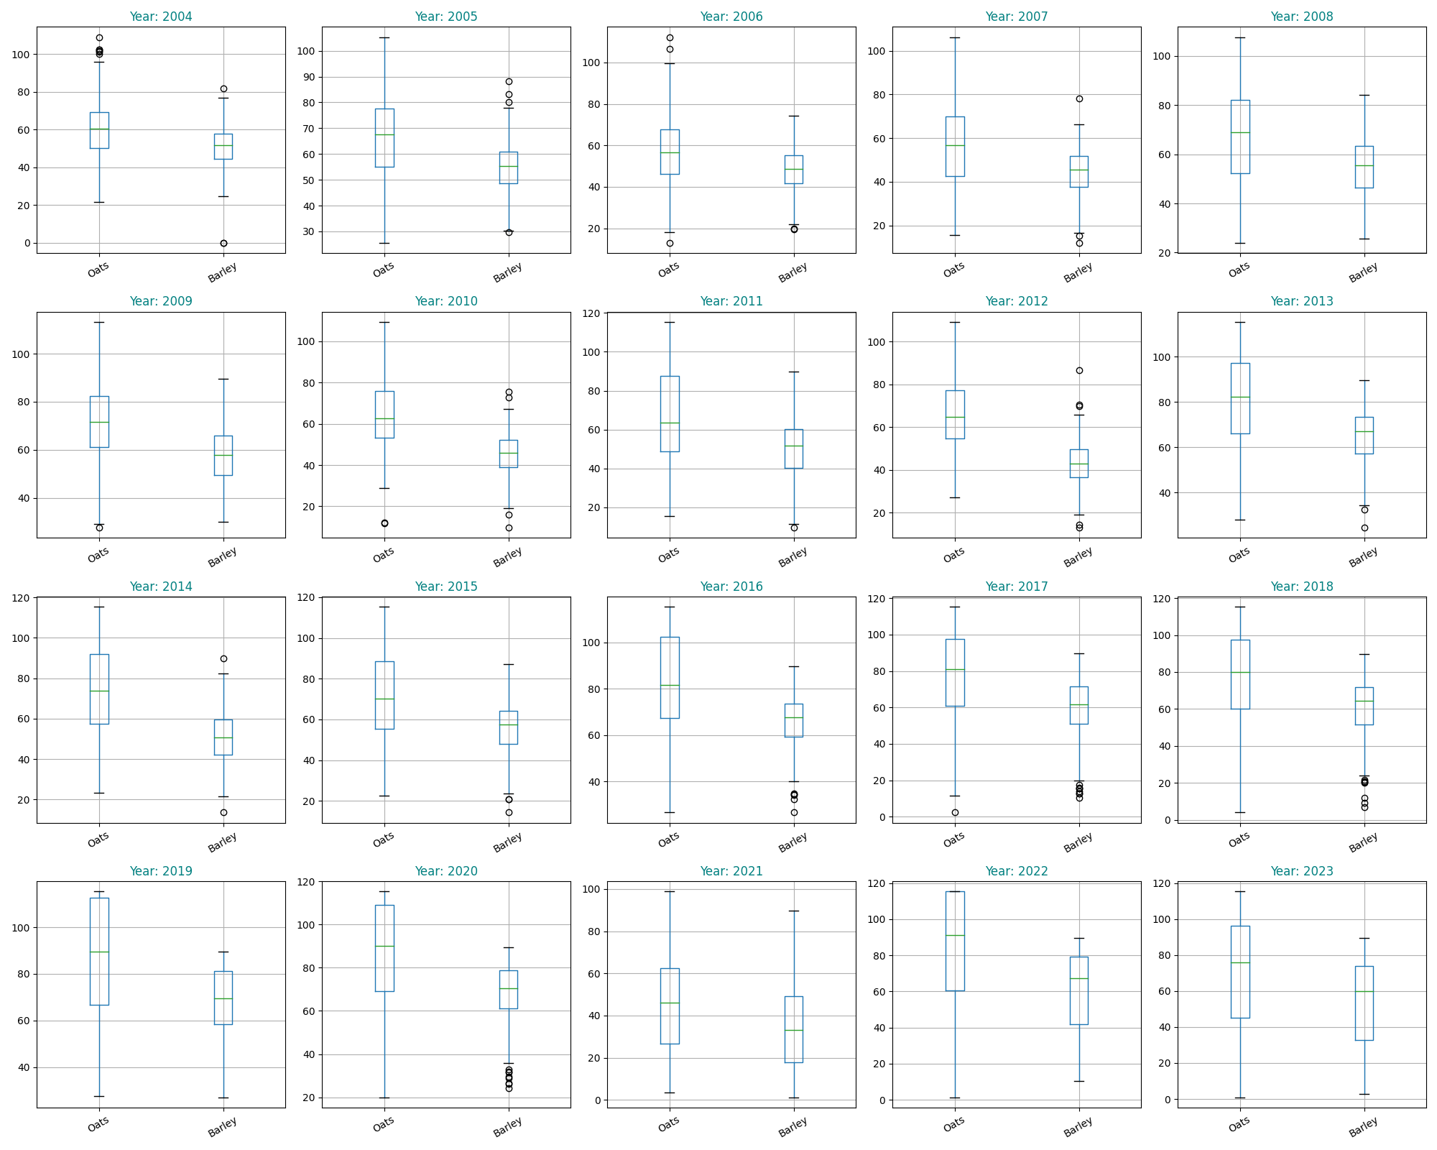
Data Preprocessing
Before outlier Treatment
After outlier Treatment
Before Treatment: Raw data with inconsistencies, missing values, and outliers.
After Treatment: Cleaned data with handle missing values, normalized values, and removed outliers for better model performance.

Slide 8
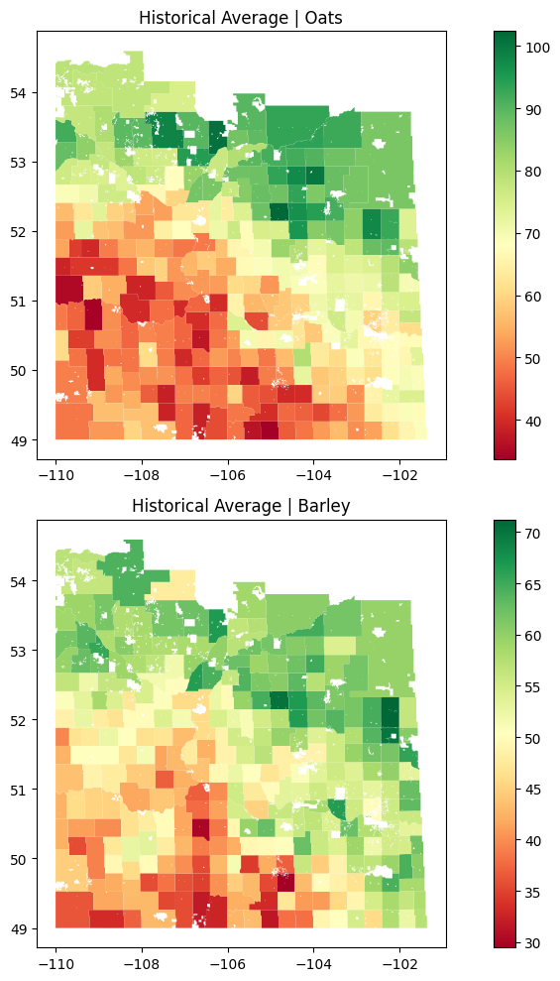
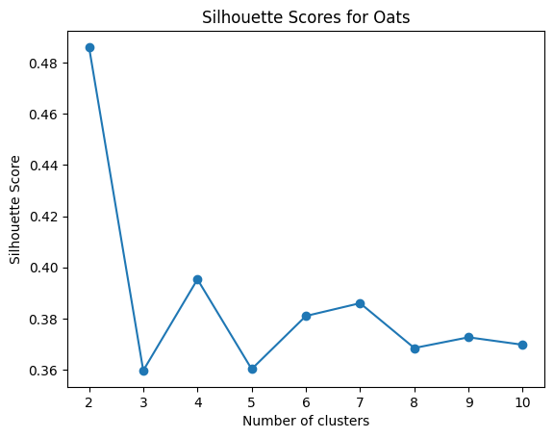
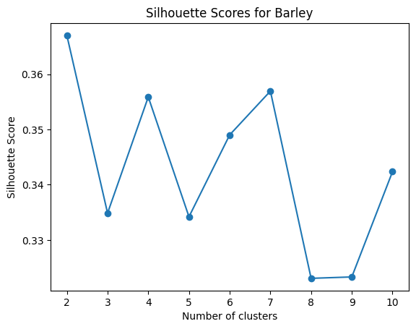
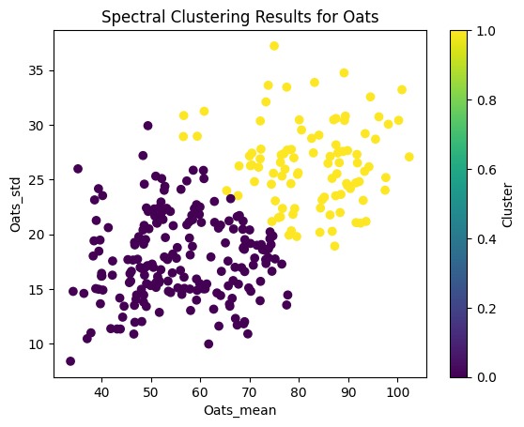
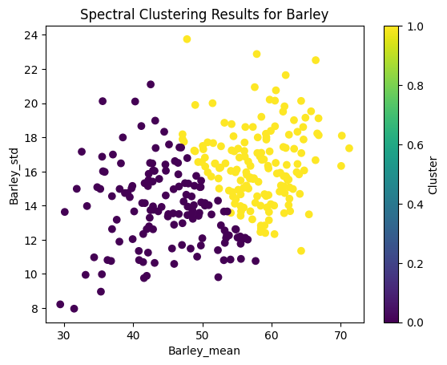
Cluster Analysis
Optimal number of clusters for both Oats and barley is 2
- Determined the optimal number of clusters using the Elbow method.
- Found that the best number of clusters for both oats and barley is 2.
- This clustering approach helps in understanding localized production patterns

Slide 9
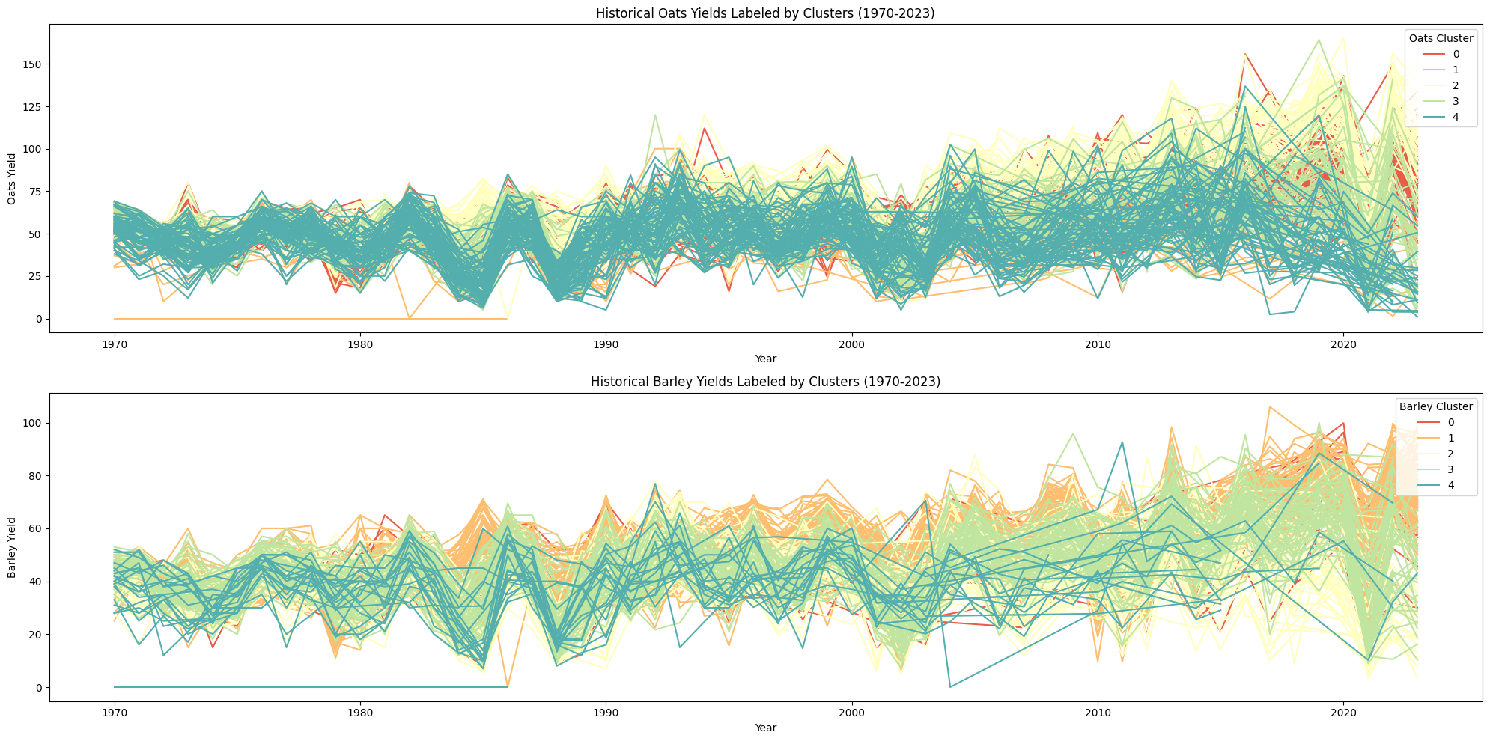
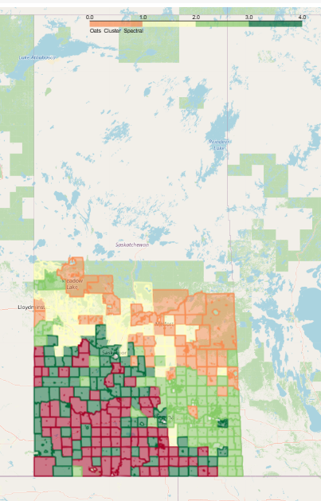
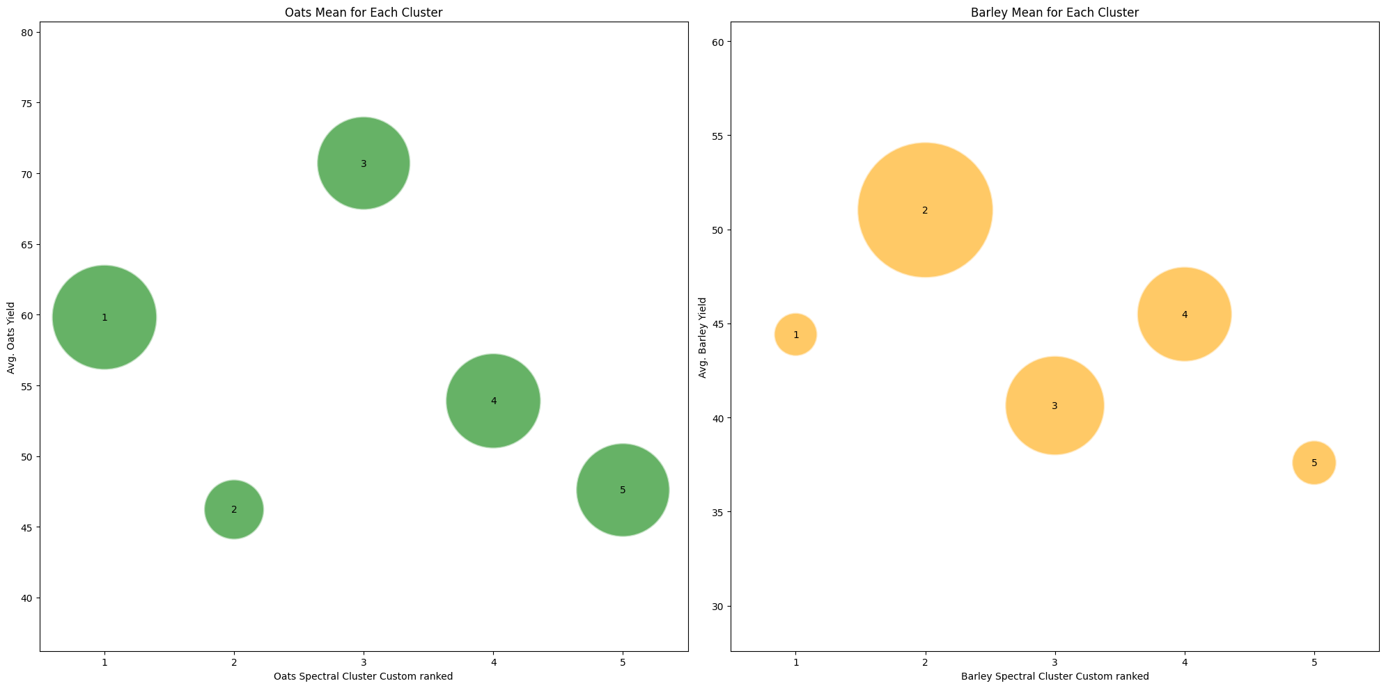
Cluster Analysis

Slide 10
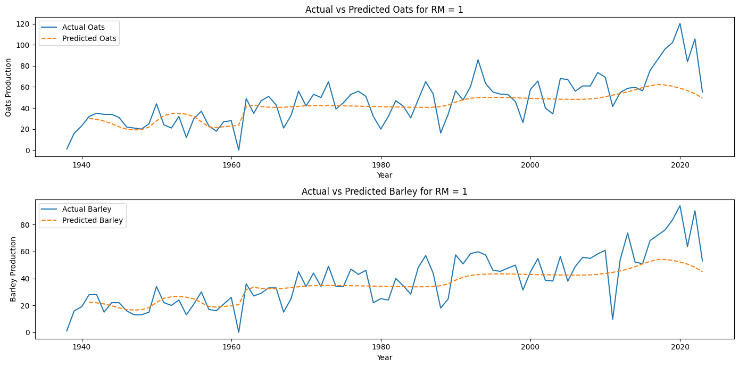
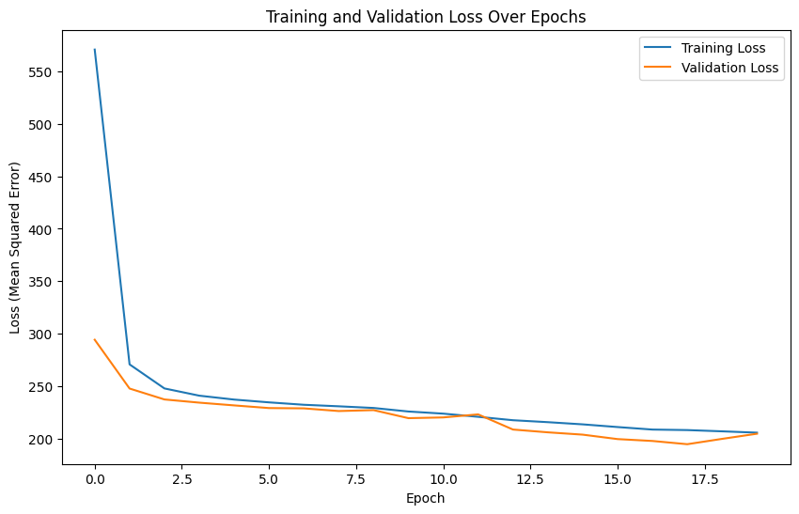
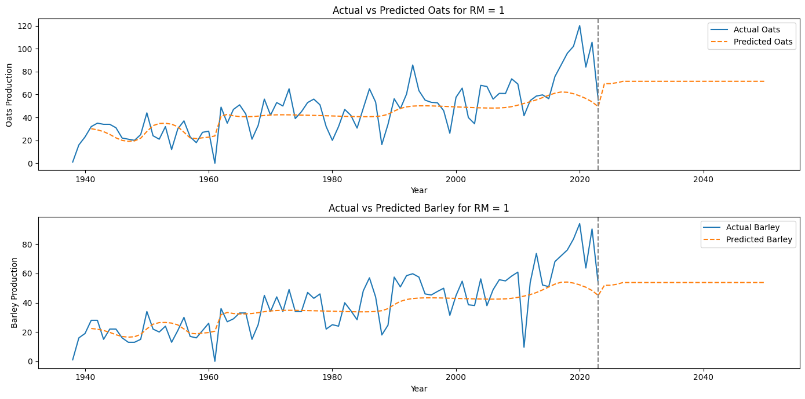
Future Prediction
LSTM Network Architecture:
Time steps: 3
First layer: 50 LSTM units with three time steps at a time
Second layer: 50 LSTM units
Dense output layer: 2 units
Optimizer: Adam
Loss function: Mean squared error
Epoch: 20
LSTM is used for time series prediction, effectively capturing temporal dependencies in crop production data.

Slide 11

Result & Implication
The model achieved significant accuracy in predicting future crop production trends.
These predictions enable better resource allocation, crop planning, and decision-making for farmers and policymakers.
The approach supports the agricultural sector in managing uncertainty and improving productivity.

Slide 12

Conclusion & future work
Successfully demonstrated the effectiveness of clustering and LSTM methods in predicting crop production.
Future work will focus on incorporating additional features such as weather forecasts and economic indicators.
Plans to integrate real-time data for even more accurate predictions, further aiding decision-making processes.
Future is FarmGPT

Slide 13
Source Code
Stream_3_Oats_Barley_PreprocessingNClustering https://colab.research.google.com/drive/1zhNR7VjXpuh7B__PuCIWn-TVFpt7auOe?usp=sharing
Stream_3_Oats_Barley_Future_Prediction_LSTM https://colab.research.google.com/drive/1P8dH0LxyahvU4I98bbakHx952HVb0E1O?usp=sharing

Slide 14


Thank You
Oats
Barley

